Slide 1


Snow level change detection using image processing
Sudheer Arja
Somya Sawlani
Ms. Vinita Daiya

Slide 2
Motivation and Background
Our Project is on using various Image Processing techniques to measure snow level change.
WSN Avalanche Project uses wireless sensor network to identify the possibility of Avalanche occurrence.
Each sensor is called node and there will be an embedded system along with it. Reference poles and low power cameras are being set near them.
We need to observe various parameters such as temperature, pressure and snow level etc. At the site.

Slide 3
Objectives
For the Embedded systems to evaluate, we need to provide the required environment and programming files.
Our aim is to develop an optimized Algorithm and implement the same in Python3 environment.
Why Python?
We need to maintain between the accuracy and power usage by the embedded system.

Slide 4
Literature Survey
So as the first step, we have done a literature survey on level detection to gain some pre-requisite knowledge.
For the survey, we went through many research papers online and got a basic outline regarding the project.
We have briefly divided the process of Image Processing for level detection into three steps:
Image filtering.
Image segmentation.
Analysis and calibration.

Slide 5
Literature Survey: Image Filtering
Image filtering is generally the first step in any Image Processing technique.
This is nothing but applying an image filter over the image for smoothening, changing contrast etc.
Image filters generally use kernel convolution method.

Slide 6
Literature Survey: Image Filtering
Kernel is nothing but a small matrix or a 2D array.
Convolution is a mathematical operation applied on two functions expressing how one can modify the shape of other.
Most commonly used filters are Gaussian Filter and RGB to Grayscale filter.

Slide 7
Literature Survey: Image Segmentation
Image Segmentation is nothing but partitioning an image into many segments.
This step is mainly done for simplifying analysis. ROI, Edge Detection and Thresholding are mostly used.
Thresholding creates a binary image by setting a pixel intensity from original image.

Slide 8
Literature Survey: Image Segmentation
Widely used edge detection algorithms are:
Canny Edge detection operator
Sobel Edge detection operator
Prewitt Edge detection operator
Laplacian Edge detection operator(uses second derivatives)
All the edge detection operators calculate gradients or second derivatives. Then uses Thresholding on them.

Slide 9
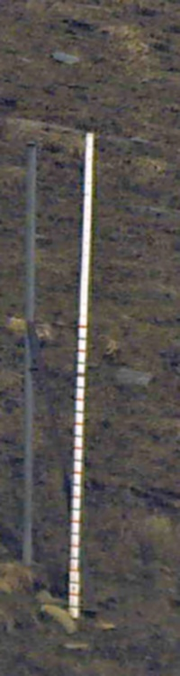
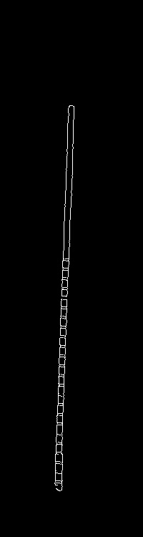
Image Segmentation
Reference Pole in field image
After applying Canny

Slide 10
Algorithm Development
For the Algorithm development we have used Canny edge detection operator because:
It is able to detect both strong and weak edges.
Maintains the edges very thin and precise.
More efficient than Sobel and Prewitt. By noise cancellation and Hysteresis Thresholding.
But Canny edge detection operator is computationally more expensive.

Slide 11
Hough Line Transformation
It is a popular technique to detect any shape, if we can represent that shape in mathematical form.
It can detect the shape even if it is broken or distorted a little bit.
In Computer vision it is mainly used for counting the no of edges and edges length obtained using edge detection methods.

Slide 12
Hough Line Transformation
The Hough Line transformation in computer vision calculates the parameters for all the pixels.
Thus forming Hough space for the expression with the parameters.
We then use some Threshold value to identify the required lines in the image.
As this requires so much processing time. We modified algorithm to use Probabilistic Hough line Transformation.

Slide 13
Hough Line Transformation
Probabilistic Hough line Transform is an optimization of Hough line transform.
Instead of taking all the points into consideration, it only takes random subsets of points and that is sufficient for line detection.
However, we need to decrease the Threshold for this. As it creates a week Hough space.
This gives an output of the lines end points instead of the Hough space.

Slide 14
Code Development: Phase 1

Slide 15
Code Development: Phase 2
We developed a code to detect the snow level just by using image processing techniques on the images.
Reference pole Calculations:
To estimate the snow level cover in a region we used pole length differences
We need the pole length before snow fall and the pixel to metric ratio.
We calculated these manually using ROI and line command.

Slide 16
Code Development: Phase 2
Snow Level Detection:
We have used Canny for edge Detection. Hough Line transformation for line detection.
We have separated the lines found by Hough which are greater than 85 degrees from horizontal.
The lines detected by Hough are at least 135 in pixel length. So, we can avoid noise. This threshold can be adjusted.
From the separated lines we have taken the two lines which are most closer to 90 degrees with horizontal.

Slide 17
Code Development: Phase 2
Snow Level Detection:
From the selected two lines we get the start point and end point.
Case(1): If the lines have a difference in lengths less than 20 pixels then we take the mid points of selected lines end points.
Case(2): If not then we use the largest of the lines.
We have done this to avoid distorted line detections by Hough as shown in the images.

Slide 18
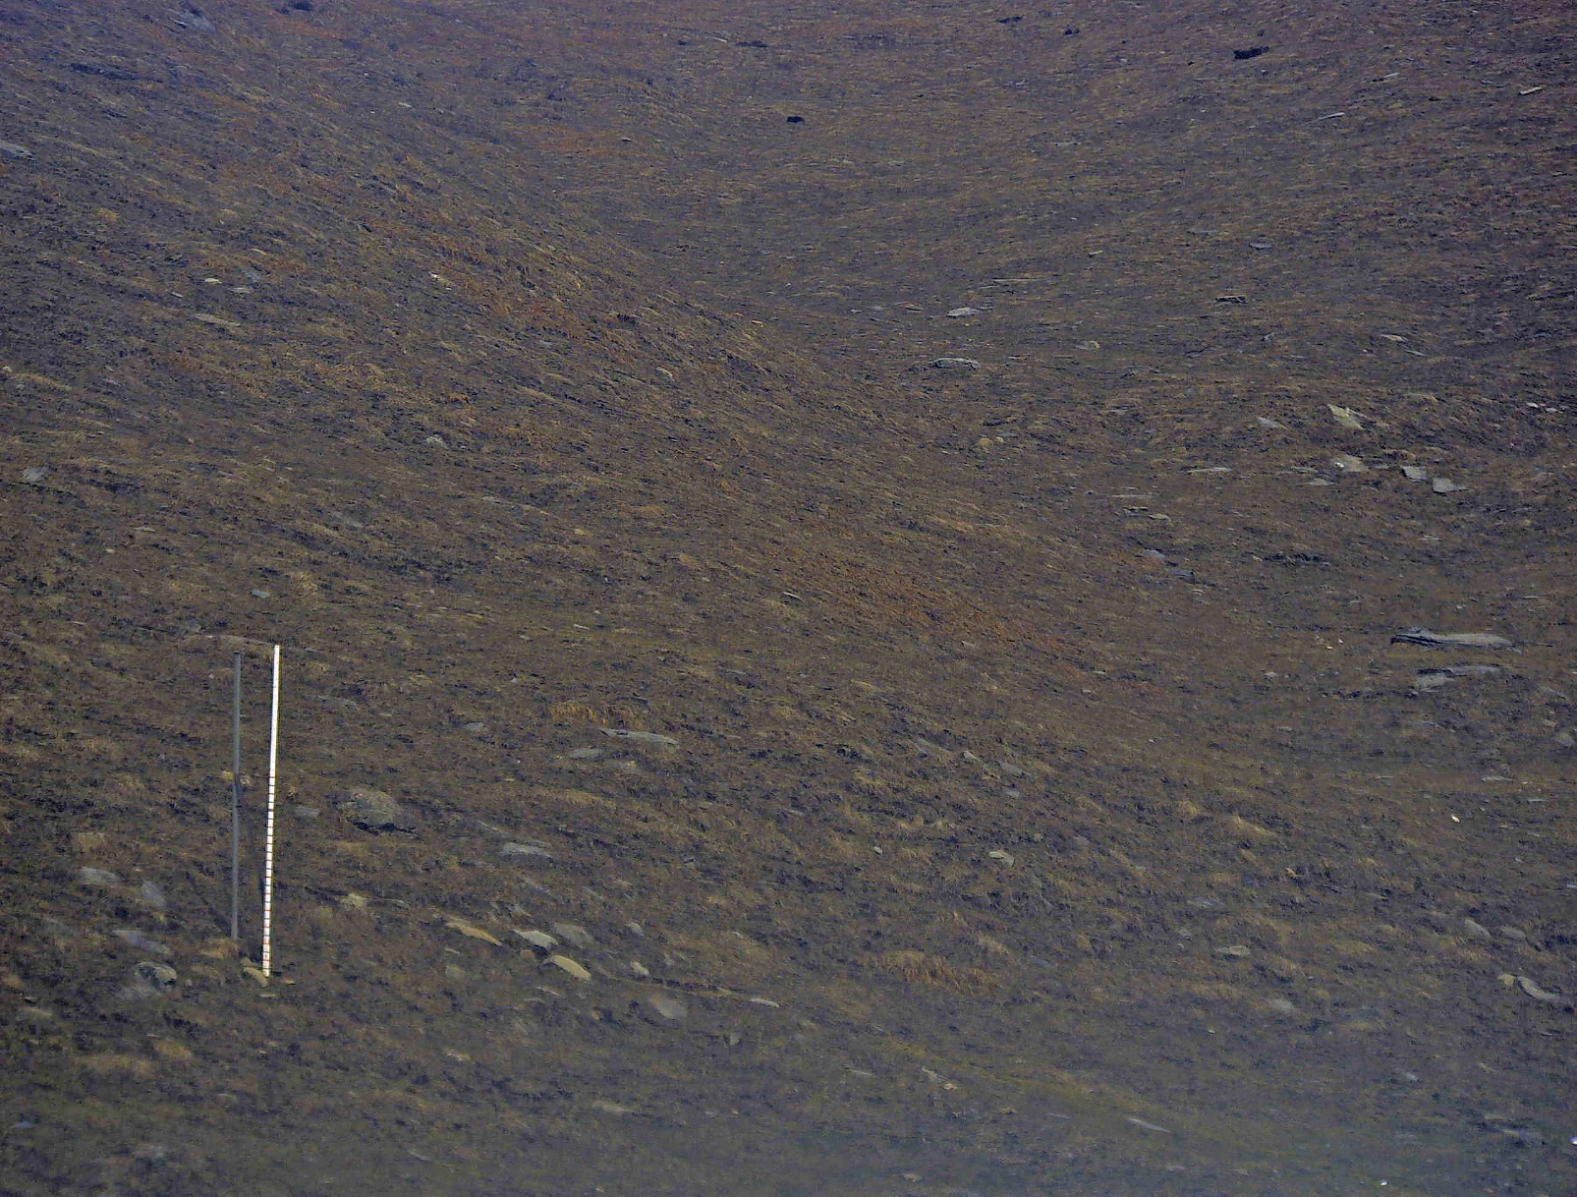
Code Development: Phase 2

Slide 19
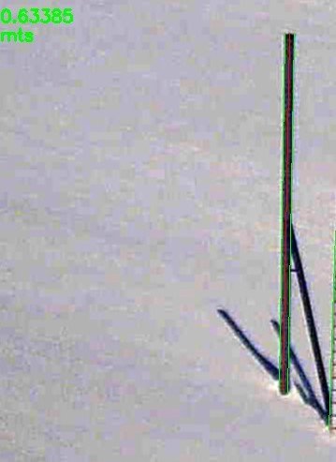
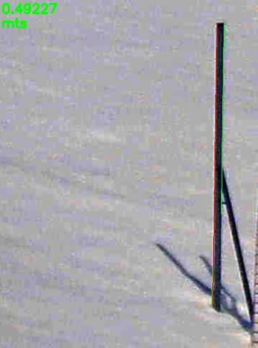
Code Development: Phase 2

Slide 20
Code Development: Phase 2

Slide 21
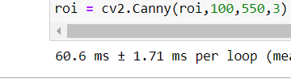

Optimization and Complexity
We have tried to optimize the code by explicitly defining the Canny operator.
We have tried using findContours method but the results were not satisfactory.
The Cyclomatic Complexity for the code has not crossed the threshold of 15 on evaluation using Lizard.
Inbuilt Canny Operator
Manually written Operator

Slide 22
Results and Discussion
We have developed an algorithm for edge length calculation.
We have searched for optimal Edge detection Algorithms for the Project.
We have developed the code for the Snow level detection in Python 3 using OpenCV in Jupyter.
Image type/method | Canny CPU usage% | Sobel CPU usage% | Prewitt CPU usage%
JPEG | 20 | 21 | 22
PNG | 19 | 31 | 29

Slide 23
Results and Discussion
We have got high accurate results from the developed code in phase-1. But the tested images are simpler.
We have got considerably accurate results from the developed code in phase-2.
We have tested Phase-2 on 3 field images. The snow levels received are
63.38 cms
49.22 cms
111.17 cms

Slide 24
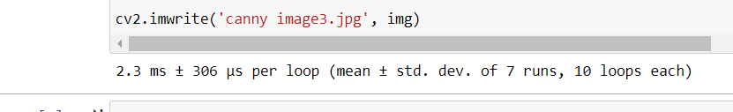
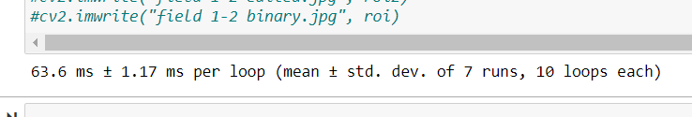
Results and Discussion
We have used timeit module in the Python3 to get the processing time for the developed codes.
Phase 1: A simple image with (198x256) Resolution
Phase 2: on using a field image with (1944x2560) Resolution.

Slide 25
Limitations
There is a maximum limit of Snow Level that can be detected. This depends on the Threshold on Hough.
We should manually adjust Threshold values and ROI. Which can affect the accuracy.
External factors like shadows which are very close to the pole can cause deviations in line detection.
Hough line detection can be affected by the resolution and accuracy of Edge detection.

Slide 26
Future Scope
We have developed the algorithm based on the traditional methods and techniques in computer vision.
To reduce the processing time even more, we have to develop the inbuilt edge detection operator.
There is a possibility to further automate the developed code using Machine Learning.
We have proposed the Algorithm and developed the code which is most suitable for the Embedded system.

